Slide 2
WELCOME PACK
Club officials
Pitch & Kit
Club info 1
Club info 2
Whole Game System & Derbyshire FA
DBS
Accidents & Emergencies
Links

Slide 3
Club Officials
Chairman – David Toplis
Secretary – Ralph Emmerson – ralph.emmerson@sky.com
Treasurer – Steve Chapman
Club Welfare Officer – Alison Hardy – aliehardy@hotmail.co.uk

Slide 4
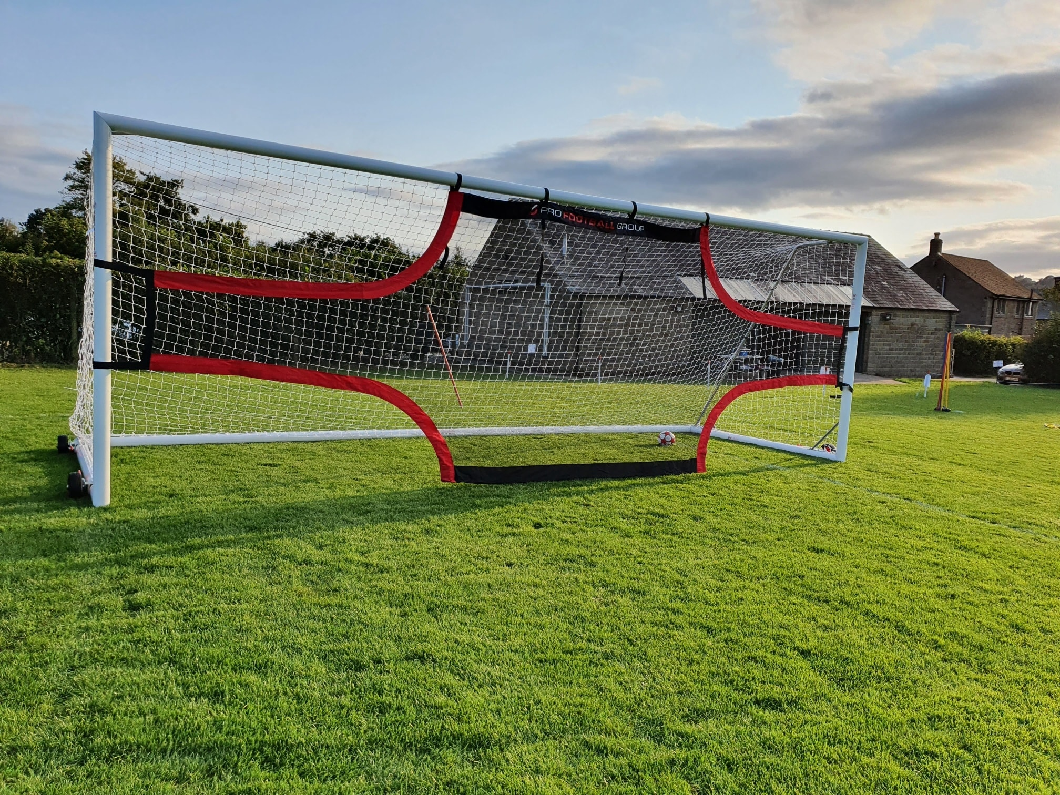
Fete Field
Tansley
DE4 5FU
Kit Colour
Sky Blue & Claret

Slide 5
Club Info 1
A team needs to have 2 adults (coach/manager)
Up to date DBS, safeguarding, first aid, concussion & cardiac
1 coach/manager needs to have completed the introduction to coaching football course
If you are doing the coaching course you don’t need to do first aid or safeguarding as these are included in the coaching course
Extra assistant coaches is optional
U6 - U10 play matches at Hollingwood, Brookfield and Clowne if in the NDYFL or home and away if in the DVFL
U11 onwards play home and away matches

Slide 6
Club info 2
The club holds a meeting once a month usually the last Sunday at 6.30pm in Tansley. We also hold a tournament once a year, this is run by volunteers of the club and we appreciate any help you can offer over the tournament weekend.
Risk assessment can be found inside the Pavilion
All players must wear shin pads for training & matches.
Ratios 4 - 8yrs = 1 adult to 6 children
9 – 12yrs = 1 adult to 8 children
13 – 18yrs = 1 adult to 10 children

Slide 7
Whole Game System & Derbyshire FA
WGS
You need to create an account to generate a fan number.
This is where you find your team information, player registration, squad list & check your certificates are up to date, etc.
Derbyshire FA
You can find all the courses here
All the policies

Slide 8
DBS
All volunteers need to have a FA DBS (if you are with another club who come under Derbyshire FA you don’t need to do another). These last for 3yrs then you need to renew it.
How to complete a DBS –
Send fan number & DOB to club welfare officer to be added
Open dbs tab on WGS to activate email
Look in emails (junk), open email and follow instructions.

Slide 9
Accidents & Emergencies
Any serious injuries which require first aid need to be documented and kept safe.
A defibrillator is located on the side of Pavilion
What3words - inches edgy drape

Slide 10
LINKS
wholegame.thefa.com
www.derbyshirefa.com
thebootroom.thefa.com/learning/qualifications/introduction-to-coaching-football
thebootroom.thefa.com/learning/qualifications/online-safeguarding-children-re-certification
thebootroom.thefa.com/learning/qualifications/safeguarding-children-course
thebootroom.thefa.com/learning/qualifications/introduction-to-first-aid-in-football
linktr.ee/tansleyjuniorsfc
The link tree is where media consent, codes of conduct forms are

